Slide 1
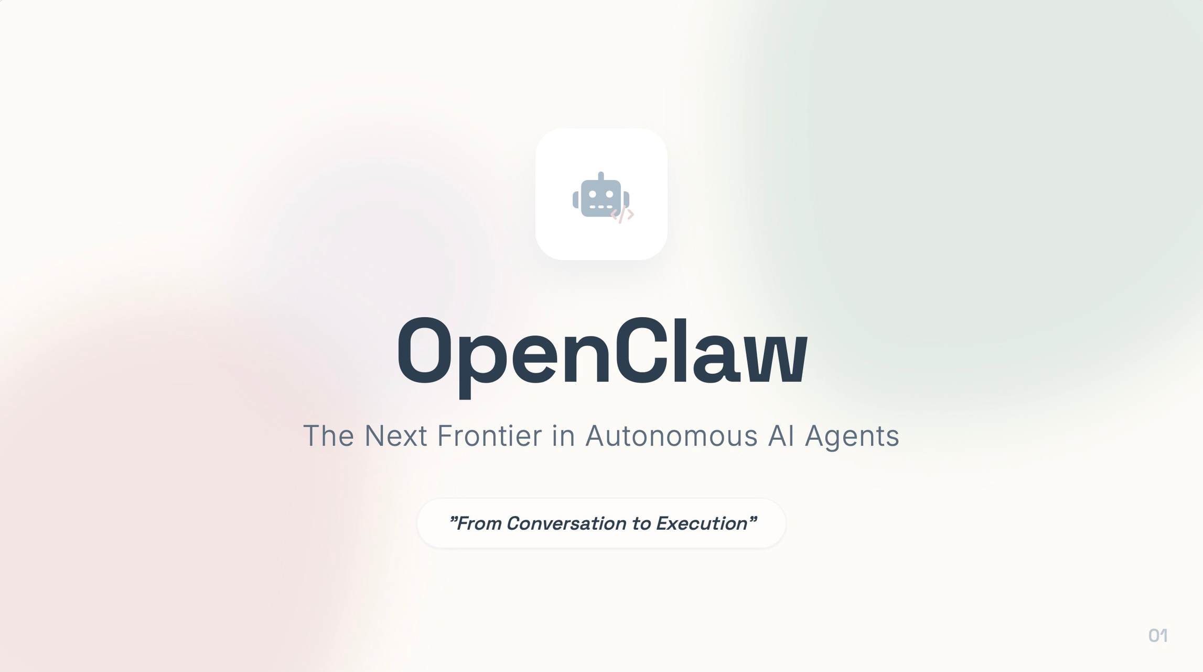

Slide 2
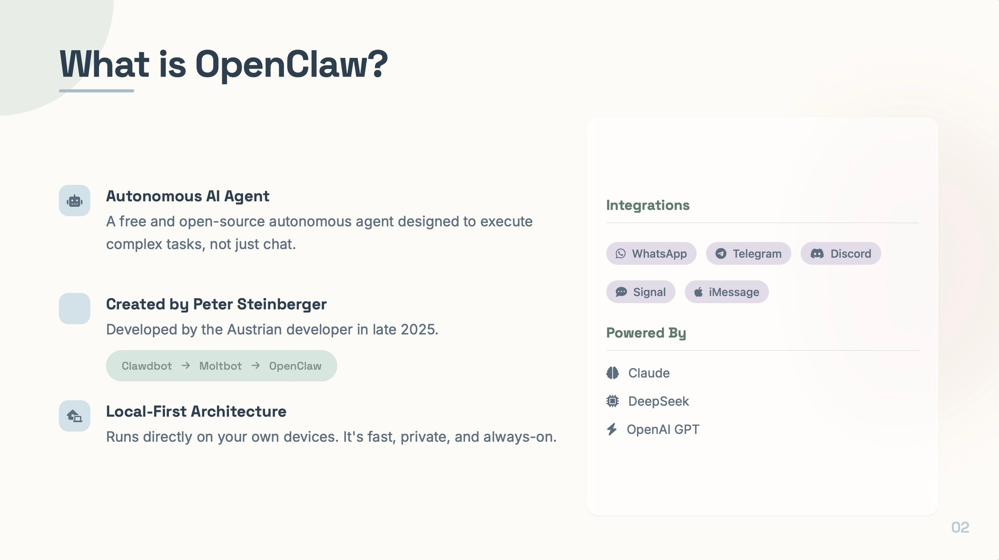


Slide 3
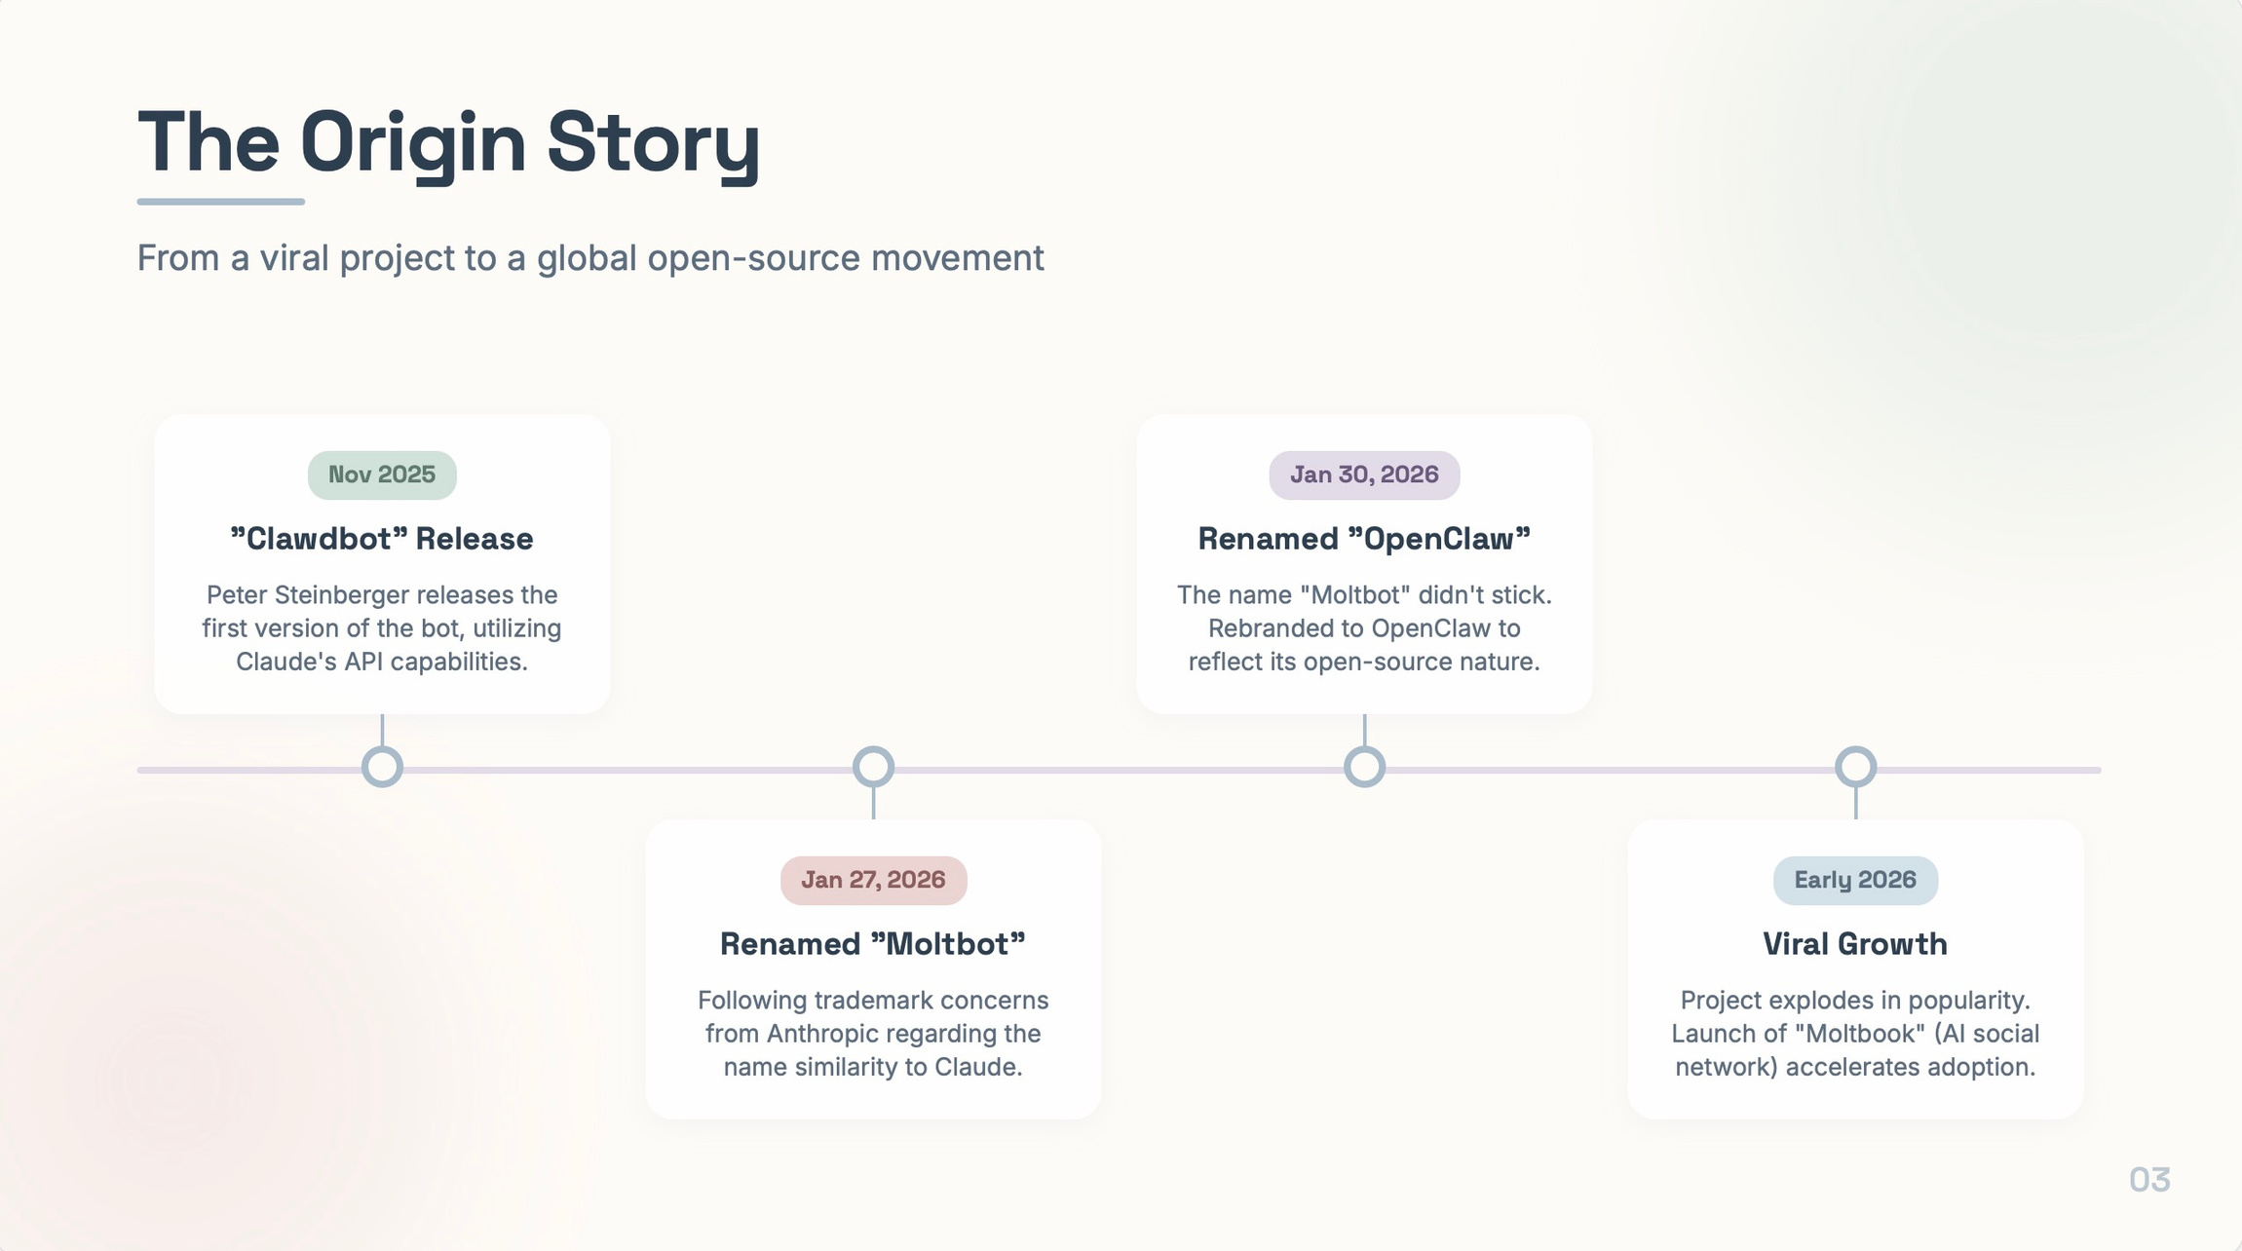
March 17, 2026
“NVIDIA GTC”
Jensen Huang calls it “The Next ChatGPT”, Announces enterprise backing with NemoClaw

Slide 4
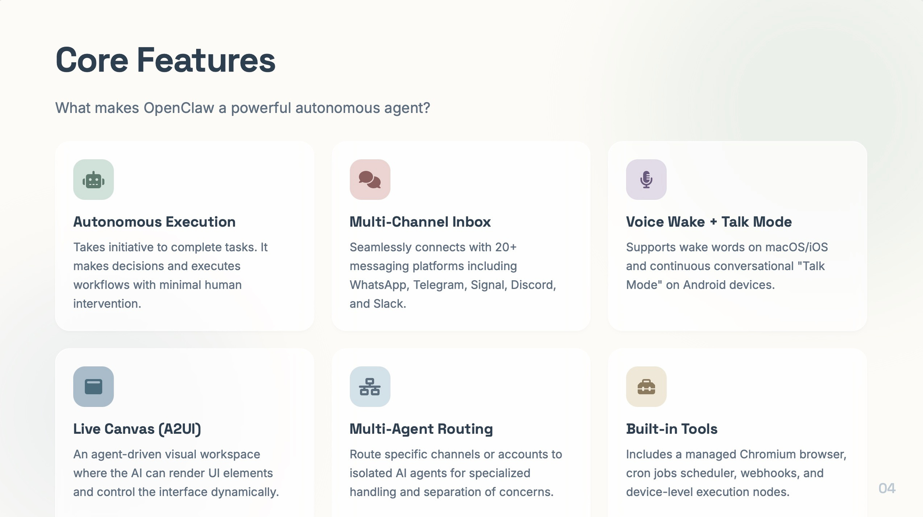

Slide 5
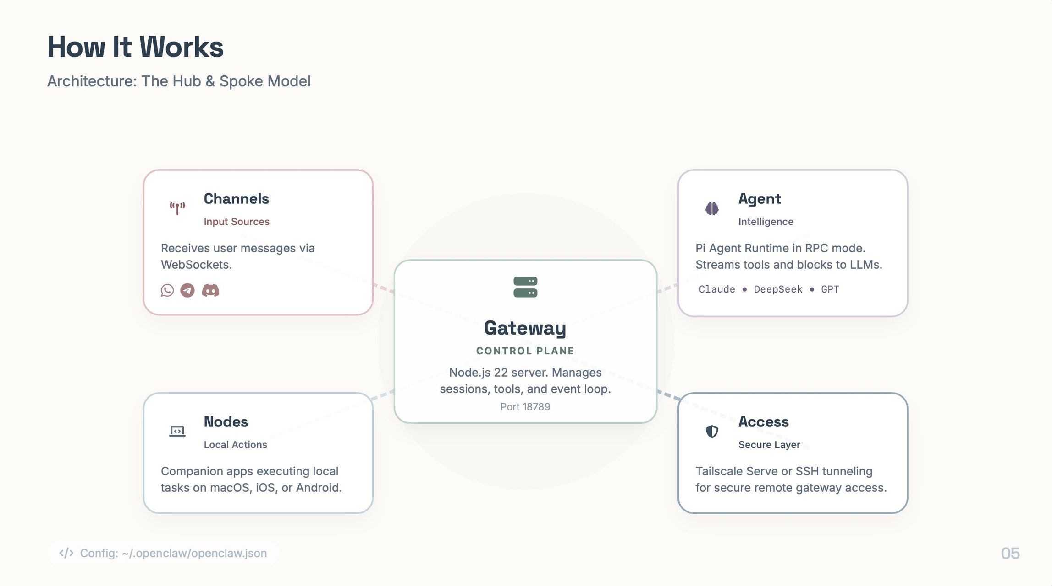

Slide 6
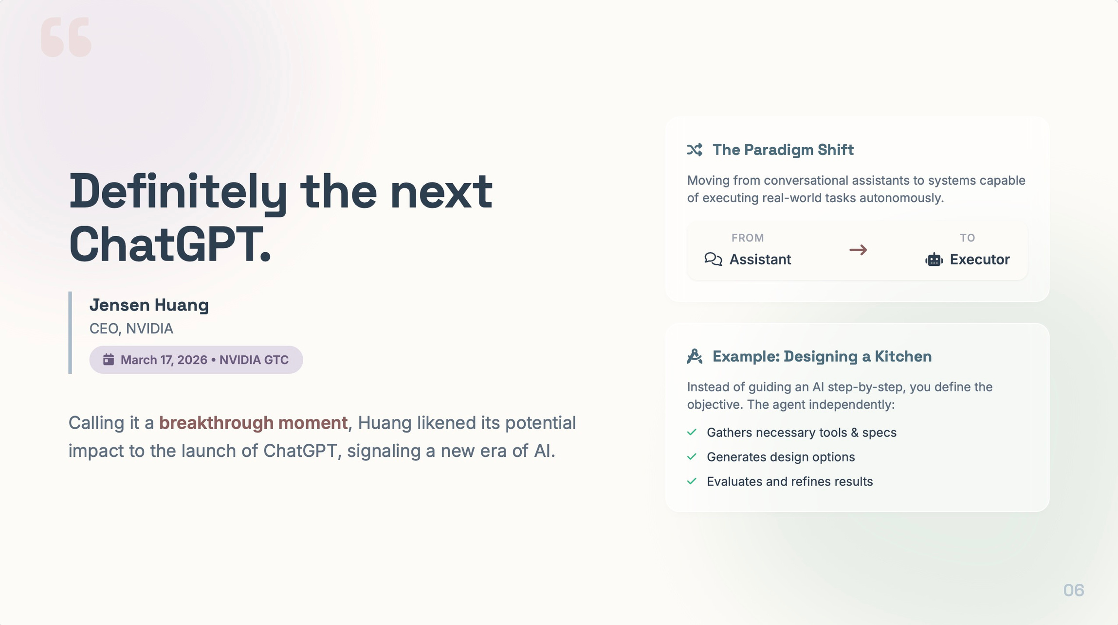
GITHUB REPO: https://github.com/openclaw/openclaw

Slide 7
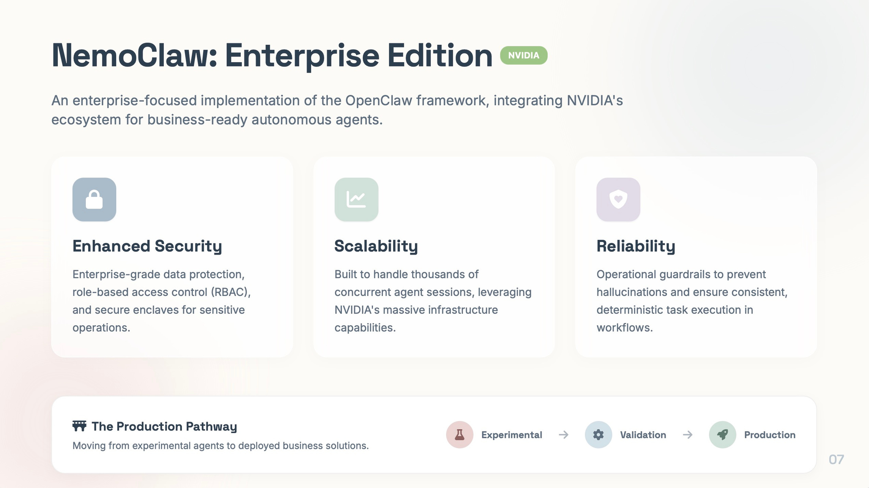

Slide 8


